Slide 1


Driving Growth with Data: A Journey Through Sales Insights and Supply Chain Optimization
(Inspired by the project "Strategic Growth in Supply Chain Operations with SQL Analytics")
Olumide Balogun +234-8065060691
by Balogun Olumide

Slide 2
Table of Contents
1. The Calm Before the Storm
2. The Meteoric Rise
3. The Unforeseen Contraction
4. The 2023 Recovery Gamble
5. The Battle for Profitability
6. Refining Strategies and Maximizing Strengths
7. The Takeaway and Impact
Olumide Balogun +234-8065060691

Slide 3


Welcome
Brace yourself for an exciting adventure where numbers come alive, data takes center stage, and stories unfold in the most unexpected ways. In this presentation, we’ll dive into the gripping saga of how data analysis rescued a floundering business from the brink of collapse, steering it toward a stunning revival. Packed with humor, intrigue, and a dash of inspiration, this is proof that even the humblest spreadsheets can hold the keys to a blockbuster comeback!
Olumide Balogun +234-8065060691

Slide 4

🌥️ The Calm Before the Storm
In the fast-paced world of business analysis, where data isn’t just numbers but the heartbeat of every decision, we embarked on a journey—one that began in 2020 with an unassuming baseline. It wasn’t the worst year for our company, but let’s face it, it was far from stellar. $142.71 million in sales, $3.45 million in profit, and 263,499 units sold. A decent performance, but not the kind that would earn a gold star on any report card. Think of it as a runner showing up to a race and crossing the finish line without breaking a sweat—just enough to keep the wheels turning.
But as Mark Twain once said, “The secret to getting ahead is getting started.” And little did we know, we were about to embark on a rollercoaster ride fuelled by raw data and a relentless drive for success. Buckle up, because things were about to get bumpy.
Olumide Balogun +234-8065060691

Slide 5

🌟 The Meteoric Rise
2021 burst onto the scene like an Afrobeat star with swagger—loud, bold, and ready to take over.
Sales skyrocketed by 132%, reaching $331.21 million, while profits followed closely with a 93.5% increase. Sales quantities? A jaw-dropping 129% boost.
To say we were thrilled would be an understatement. The data team joked that we needed a "Gravity-Free Zone" just to keep the numbers from floating away. We even considered installing a trampoline in the office for celebrations.
But amidst the joy, I couldn’t help but wonder—Can this last? Or were we about to experience the hangover of success?
Olumide Balogun +234-8065060691

Slide 6

😱 The Unforeseen Contraction
2022 hit like waking up to find your favourite TV show replaced by a boring documentary.
Sales plummeted by nearly 12%, profits grew by a humble 6%, and sales quantities shrank. Cue the collective "What the heck just happened?!" Was it market shifts, global crises, or had we been riding beginner’s luck?
Spoiler alert: It wasn’t beginner’s luck. But we were determined to figure it out. As Vince Lombardi said: “It’s not whether you get knocked down, it’s whether you get up.”
And oh, we were getting up. This wasn’t the end of the road—just a detour to somewhere new.
Olumide Balogun +234-8065060691

Slide 7

🎲 The 2023 Recovery Gamble
8.58%
9.27%
Sales Growth
Unit Sales Increase
Sales rebounded in 2023, increasing by 8.58%. We were back on track, but a new challenge emerged.
The number of units sold continued to climb, showing 9.27% growth. This indicated strong demand for our products.
-18.7%
Suddenly, all eyes were on the finance team. Why were we working so hard if the margins still looked like they’d been through a blender?
This was our moment of truth. Do we keep pushing for sales growth, or do we start playing hardball with our costs?
Profit Dip
Despite the sales growth, profits dipped by 18.7%. It was clear that we needed to shift our focus from just increasing sales to maximizing profitability.
Olumide Balogun +234-8065060691

Slide 8

⚔️ The Battle for Profitability
Our numbers painted a clear picture: Profitability was the true enemy. It wasn’t about how much we sold—it was about how much we kept. Were we slashing prices and eating into profits? Were we running a secret charity? 🫣
Our strategic recommendation? Focus on profitability. It was time to optimize costs and explore whether we could charge just a little more—without losing customers to the competition.
As Vidal Sassoon said, “The only place where success comes before work is in the dictionary”
Olumide Balogun +234-8065060691

Slide 9
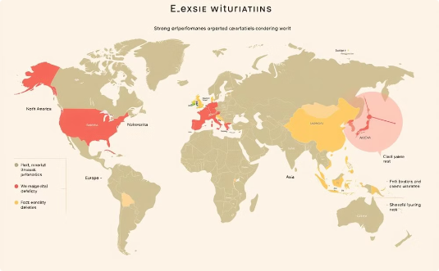

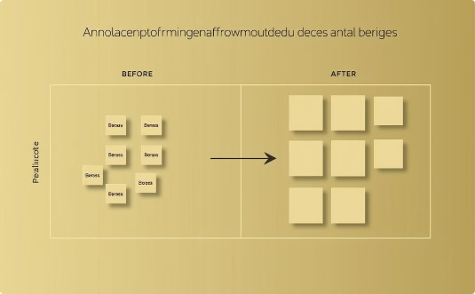
🔍 Refining Strategies and
Maximizing Strengths
Regional Performance
Product Focus
Strategic Allocation
We identified our top-performing regions: North America, Europe, and Asia. We focused our efforts on these key areas.
We concentrated on our most successful product lines: Own Brand, Distribution, and Custom Made. These were key to maximizing profitability.
We reallocated resources away from underperforming areas and focused on our strongest products and regions.
Olumide Balogun +234-8065060691

Slide 10
💡 The Takeaway and Impact
Fast forward to today: The company is thriving. We’re no longer just riding the rollercoaster—we’re driving it. Sales performance is back, and this time, it’s backed by a rock-solid game plan:
🔑
🛠️
📈
Key Finding:
Strategic Actions:
Impact:
Prioritize profit over volume
Prioritize Reallocated resources, optimized costs, and focused on customer loyalty.
A stronger foundation for sustainable growth.
Olumide Balogun +234-8065060691
As Winston Churchill said, “Success is not final; failure is not fatal: It is the courage to continue that counts.”

Slide 11

📣 Final Thoughts
This presentation shines a spotlight on the magic of storytelling through data analysis—where numbers stop being boring and start revealing hidden patterns, untapped potential, and exciting possibilities. By turning obstacles into opportunities with the power of analytics, we’ve paved the way for meaningful success. After all, data isn’t just numbers; it’s a story waiting to be told, and we can’t wait to see how the next chapter unfolds for our company!
Olumide Balogun +234-8065060691

Slide 12


A Big Data Hug
Thank you for diving headfirst into this data-packed adventure! Your curiosity turns boring spreadsheets into blockbusters, and your engagement makes all the number-crunching worth it. Together, we’re not just analyzing data—we’re sparking “aha” moments, uncovering hidden treasures, and turning stats into success stories.
Stay curious, stay inspired, and remember: the magic is in the numbers (but only if you look closely)!
– Olumide

Slide 13
BALOGUN OLUMIDE CHRIS CONTACTS
Tel: +234(0)8065060691
Email: krisbalo11@gmail.com
Github - https://github.com/olumidebalogun1
LinkedIn - https://www.linkedin.com/in/olumide-balogun1/
Medium - https://medium.com/@Olumide-Balogun
X - https://x.com/IAmOluBalogun

